Slide 1
Modern Optics
P47 – Optics: Unit 9

Slide 2
Unit 9
Course Outline
Unit 1: Electromagnetic Waves
Unit 2: Interaction with Matter
Unit 3: Geometric Optics
Unit 4: Superposition of Waves
Unit 5: Polarization
Unit 6: Interference
Unit 7: Diffraction
Unit 8: Fourier Optics
Unit 9: Modern Optics

Slide 3
Unit 9
Two Criteria for Laser Operation
LASER: Light Amplification by Stimulated Emission of Radiation
Coherent amplification of an optical field
Stimulated emission of radiation
Population inversion in a 3 (or more) level system
Feedback from an optical cavity
Fabry-Perot with partial reflector: Longitudinal modes
Mirror curvature: Transverse modes and Gaussian beams
Laser stability criteria, geometric optics, ABCD matrix.

Slide 4
Unit 9
Quantized Absorption & Emission
The quantum nature of light was first recognized in the context of absorption and emission by matter
Photoelectric effect
ejection of photoelectron by EM field
Blackbody Radiation
Stefan-Boltzmann
Wien’s Law
Planck Blackbody Spectrum

Slide 5
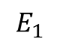
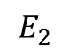
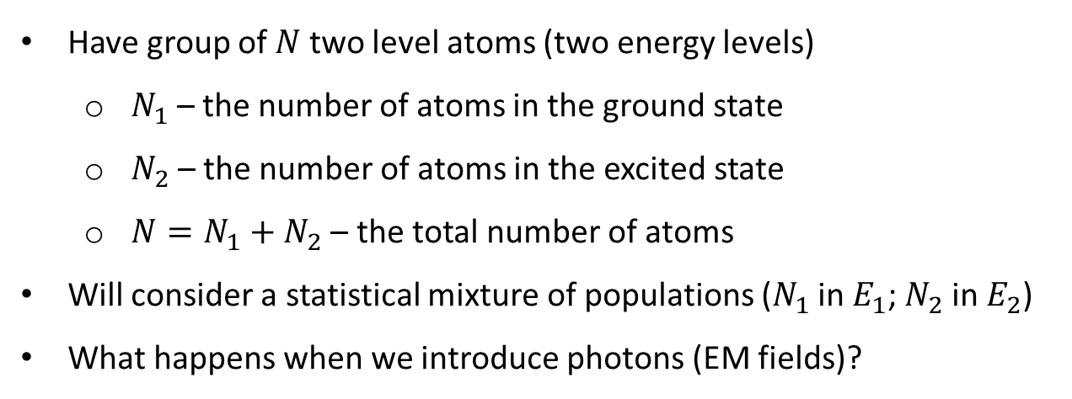
Unit 9
A Collection of Two-Level Atoms
$$E_{2}$$
$$E_{1}$$
Have group of $N$ two level atoms (two energy levels)
$N_{1}$– the number of atoms in the ground state
$N_{2}$– the number of atoms in the excited state
$N=N_{1}+N_{2}$ – the total number of atoms
Will consider a statistical mixture of populations ($N_{1}$ in $E_{1}$; $N_{2}$ in $E_{2}$)
What happens when we introduce photons (EM fields)?

Slide 6
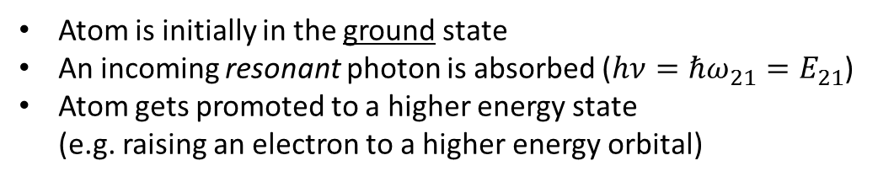
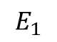
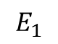
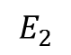
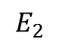
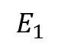
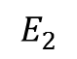
Unit 9
Optical Absorption
Energy Level Diagram
$$E_{2}$$
$$E_{2}$$
$$E_{2}$$
$$E_{1}$$
$$E_{1}$$
$$E_{1}$$
Atom is initially in the ground state
An incoming resonant photon is absorbed ($hν=ℏω_{21}=E_{21}$)
Atom gets promoted to a higher energy state (e.g. raising an electron to a higher energy orbital)
If this is the only allowed process, what will happen to a collection of atoms illuminated continuously?

Slide 7
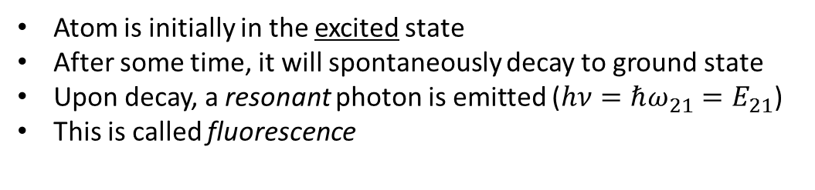
Unit 9
Spontaneous Emission
Energy Level Diagram
$$E_{2}$$
$$E_{2}$$
$$E_{2}$$
$$E_{1}$$
$$E_{1}$$
$$E_{1}$$
Atom is initially in the excited state
After some time, it will spontaneously decay to ground state
Upon decay, a resonant photon is emitted ($hν=ℏω_{21}=E_{21}$)
This is called fluorescence
If this is the only allowed process, what will happen to a collection of atoms initially in the excited state?

Slide 8
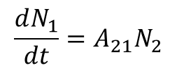
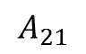
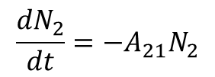
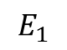
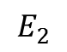
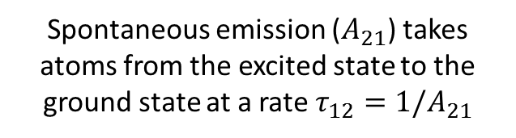

Unit 9
Einstein Rate Equations
(No Driving Field)
$$E_{2}$$
$$A_{21}$$
$$E_{1}$$
Spontaneous emission ($A_{21}$) takes atoms from the excited state to the ground state at a rate $τ_{12}=1/A_{21}$
Excited State:
$$\frac{dN_{2}}{dt}=−A_{21}N_{2}$$
($τ_{12}∼$ nanoseconds)
Ground State:
$$\frac{dN_{1}}{dt}=A_{21}N_{2}$$
Any population in the excited state decays exponentially
$$N_{2}\left(t\right)=N_{2}\left(0\right)e^{−A_{21}t}=N_{2}\left(0\right)e^{−t/τ_{12}}$$

Slide 9
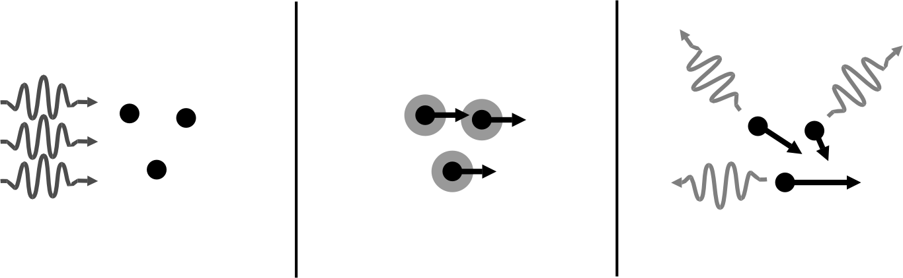
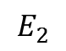
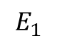
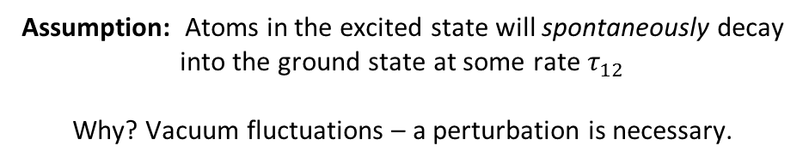
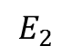
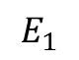
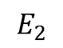
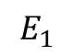
Unit 9
Absorption Followed by Spontaneous Emission
Energy Level Diagram
$$E_{2}$$
$$E_{2}$$
$$E_{2}$$
$$E_{1}$$
$$E_{1}$$
$$E_{1}$$
Momentum Space Diagram
Assumption: Atoms in the excited state will spontaneously decay into the ground state at some rate $τ_{12}$
Why? Vacuum fluctuations – a perturbation is necessary.

Slide 10
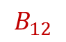
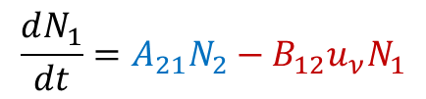
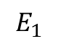
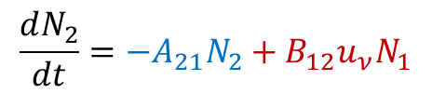
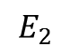
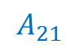
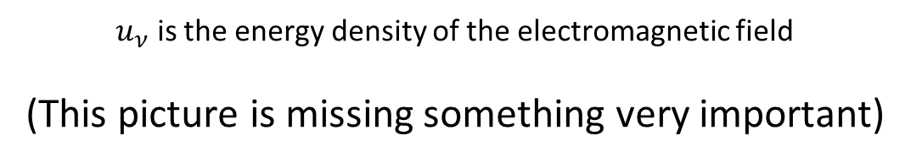
Unit 9
Einstein Rate Equations
(with Driving Field)
$$E_{2}$$
$$A_{21}$$
$$B_{12}$$
$$E_{1}$$
Excited State:
$$\frac{dN_{2}}{dt}=−A_{21}N_{2}+B_{12}u_{ν}N_{1}$$
Ground State:
$$\frac{dN_{1}}{dt}=A_{21}N_{2}−B_{12}u_{ν}N_{1}$$
$u_{ν}$ is the energy density of the electromagnetic field
(This picture is missing something very important)

Slide 11
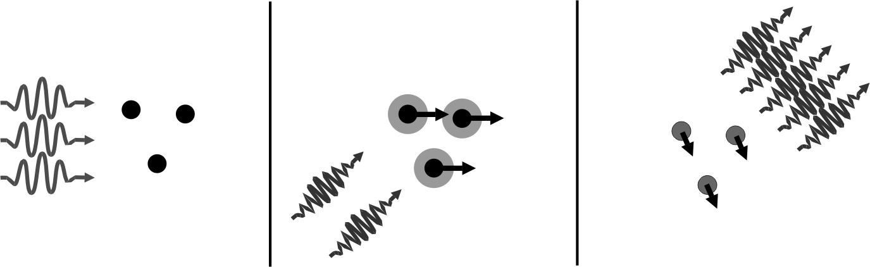
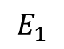
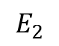
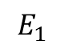
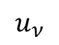
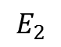
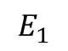
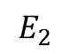
Unit 9
Absorption Followed by Stimulated Emission
Energy Level Diagram
$$E_{2}$$
$$E_{2}$$
$$E_{2}$$
$$u_{ν}$$
$$E_{1}$$
$$E_{1}$$
$$E_{1}$$
Momentum Space Diagram
identical
This time, the rate that photons are emitted depends on the spectral energy density of the external field, $u_{ν}$.
Einstein realized that this must happen for the theory to be self-consistent
(ultimately what makes lasers possible…)

Slide 12
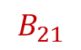
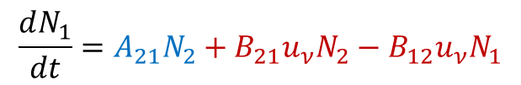
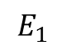
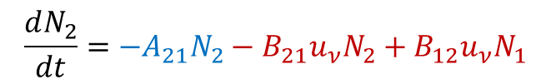
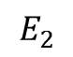
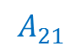
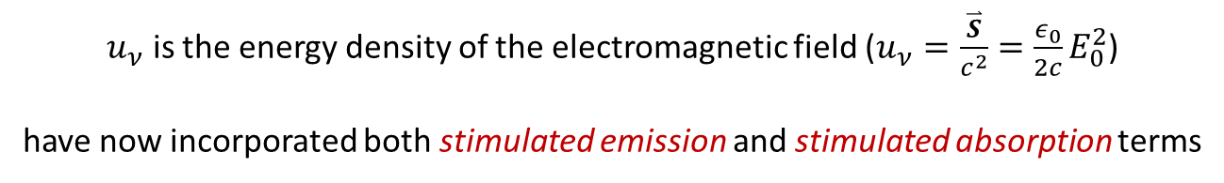
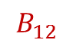
Unit 9
Einstein Rate Equations
(with actual Driving Field)
$$E_{2}$$
$$A_{21}$$
$$B_{12}$$
$$B_{21}$$
$$E_{1}$$
Excited State:
$$\frac{dN_{2}}{dt}=−A_{21}N_{2}−B_{21}u_{ν}N_{2}+B_{12}u_{ν}N_{1}$$
Ground State:
$$\frac{dN_{1}}{dt}=A_{21}N_{2}+B_{21}u_{ν}N_{2}−B_{12}u_{ν}N_{1}$$
$u_{ν}$ is the energy density of the electromagnetic field ($u_{ν}=\frac{\overset{⃑}{S}}{c^{2}}={\frac{ε_{0}}{2c}E}_{0}^{2}$)
have now incorporated both stimulated emission and stimulated absorption terms

Slide 13
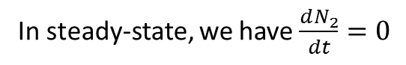
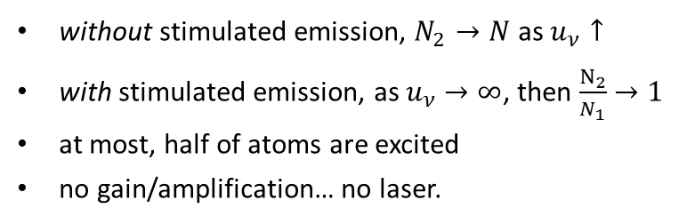



Unit 9
Einstein Rate Equations
(Steady-State Case)
$$E_{2}$$
$$A_{21}$$
$$B_{12}$$
$$B_{21}$$
Take rate equation for the exited state:
$$E_{1}$$
$$\frac{dN_{2}}{dt}=−A_{21}N_{2}−B_{21}u_{ν}N_{2}+B_{12}u_{ν}N_{1}$$
In steady-state, we have $\frac{dN_{2}}{dt}=0$
$$0=−A_{21}N_{2}−B_{21}u_{ν}N_{2}+B_{12}u_{ν}N_{1}$$
$$N_{2}{(A_{21}+B}_{21}u_{ν})={N_{1} B}_{12}u_{ν}$$
$$\frac{N_{2}}{N_{1}}=\frac{B_{12}u_{ν}}{{A_{21}+B}_{21}u_{ν}}$$
without stimulated emission, $N_{2}→N$ as $u_{ν}↑$
with stimulated emission, as $u_{ν}$ $→∞$, then $\frac{N_{2}}{N_{1}}$ $→1$
at most, half of atoms are excited
no gain/amplification… no laser.

Slide 14


Unit 9
Einstein Rate Equations
(Coefficient Relations)
$$E_{2}$$
$$A_{21}$$
$$B_{12}$$
$$B_{21}$$
$$\frac{N_{2}}{N_{1}}=\frac{B_{12}u_{ν}}{{A_{21}+B}_{21}u_{ν}}$$
$$E_{1}$$
To get values for $A$ and $B$ requires knowledge of the specific atomic system and a quantum mechanical calculation…
BUT…
These are called the Einstein coefficients because he showed that there is an important connection between these three different coefficients, independent of the fine details.

Slide 15



Unit 9
Einstein Rate Equations
(Coefficient Relations)
$$E_{2}$$
$$A_{21}$$
$$B_{12}$$
$$B_{21}$$
$$\frac{N_{2}}{N_{1}}=\frac{B_{12}u_{ν}}{{A_{21}+B}_{21}u_{ν}}$$
$$E_{1}$$
We’ll use specific information about the behavior of the two parts of this system in thermal equilibrium
1) Boltzmann: How much population must be in state 2 at temperature T ?
$$\frac{N_{2}}{N_{1}}=e^{−{(E_{2}−E_{1})/k}_{B}T}$$
$$=e^{−{hν_{21}/k}_{B}T}=\frac{B_{12}u_{ν}}{{A_{21}+B}_{21}u_{ν}}$$
$$u_{ν}=\frac{{A_{21}/B}_{21}}{\left({B_{12}/B}_{21}\right)e^{{hν_{21}/k}_{B}T}−1}$$
(population dependence eliminated!)

Slide 16





Unit 9
Einstein Rate Equations
(Coefficient Relations)
$$E_{2}$$
$$A_{21}$$
$$B_{12}$$
$$B_{21}$$
$$u_{ν}=\frac{{A_{21}/B}_{21}}{\left({B_{12}/B}_{21}\right)e^{{hν_{21}/k}_{B}T}−1}$$
$$E_{1}$$
We’ve eliminated dependence on population, now eliminate dependence on spectral power…
2) Planck Blackbody Spectral Energy Density:
$$u_{ν}=\frac{8πhν^{3}}{c^{3}}\left[\frac{1}{e^{\frac{hν}{k_{b}T}}−1}\right]$$
$$=\frac{{A_{21}/B}_{21}}{\left({B_{12}/B}_{21}\right)e^{{hν_{21}/k}_{B}T}−1}$$
$${B=B}_{12}=B_{21}$$
$$A=\frac{8πhν^{3}}{c^{3}}B$$

Slide 17


Unit 9
Einstein Rate Equations
(Strong Driving Limit)
$$E_{2}$$
$$A_{21}$$
$$B_{12}$$
$$B_{21}$$
$$\frac{N_{2}}{N_{1}}=\frac{Bu_{ν}}{A+Bu_{ν}}<1$$
$$E_{1}$$
$N_{2}<N_{1}$ no matter how big the driving field is!
Take-Home Point: It’s impossible to create a steady-state population inversion
in a 2-level system!
If we can’t make a laser with this system….
what do we do now?
Add another level!

Slide 18











Unit 9
Laser Pumping Schemes
(Three-Level Laser)
Assume we have a third level and some process that excites the atoms to that level at a rate $R_{13}$
$$\frac{dN_{3}}{dt}=R_{13}\left(N_{1}−N_{3}\right)−A_{32}N_{3}$$
$$E_{3}$$
$$A_{32}$$
(fast)
$$E_{2}$$
$$\frac{dN_{2}}{dt}=A_{32}N_{3}−A_{21}N_{2}$$
$$R_{13}$$
$$A_{21}$$
(slow)
$$\frac{dN_{1}}{dt}=A_{21}N_{2}+R_{13}\left(N_{3}−N_{1}\right)$$
$$E_{1}$$
If the rate of spontaneous decay rate from $3→2$ is much faster than the decay rate from $2→1$ and the rate of pumping from $1→2$, something very interesting becomes possible!

Slide 19













Unit 9
Laser Pumping Schemes
(Population Inversion)
Adiabatic approximation for level 3!
$$E_{3}$$
$$A_{32}$$
(fast)
$$\frac{dN_{3}}{dt}=0=R_{13}\left(N_{1}−N_{3}\right)−A_{32}N_{3}$$
$$E_{2}$$
$$A_{21}$$
(slow)
$$N_{3}=\frac{R_{13}}{A_{32}+R_{13}}N_{1}≈\frac{R_{13}}{A_{32}}N_{1}$$
$$E_{1}$$
There’s almost no population in state 3 because it decays so fast ${ (N}_{3}≪N_{1})$
This gives us an asymmetric way to get atoms into state 2 without having the pump interaction drive them right back down again at the same rate!
$$\frac{dN_{2}}{dt}=R_{13}N_{1}−A_{21}N_{2}$$
$$E_{2}$$
$$\frac{dN_{1}}{dt}=A_{21}N_{2}−R_{13}N_{1}$$
$$R_{13}$$
$$A_{21}$$
$$E_{1}$$

Slide 20










Unit 9
Laser Pumping Schemes
(Population Inversion)
$$E_{2}$$
$$\frac{dN_{2}}{dt}=R_{13}N_{1}−A_{21}N_{2}$$
$$R_{13}$$
$$A_{21}$$
$$\frac{dN_{1}}{dt}=A_{21}N_{2}−R_{13}N_{1}$$
$$E_{1}$$
Again, look at the steady-state:
$$\frac{dN_{2}}{dt}=\frac{dN_{1}}{dt}=0$$
If we can make $R_{13}$ bigger than $A_{21},$we can now create a population inversion and make a laser!
$$\frac{N_{2}}{N_{1}}=\frac{R_{13}}{A_{21}}$$

Slide 21



Unit 9
Maiman’s Original Ruby Laser
(3-Level Pulsed Laser)
Theodore Harold "Ted" Maiman (July 11, 1927 – May 5, 2007)

Slide 22



Unit 9
Helium-Neon (HeNe) Laser
(4-Level Continuous Wave Laser)
High voltage on electrodes creates a plasma
Electron collisions pump helium into several excited states ($2$s)
Helium collides with neon and transfers its energy
With sufficient pumping, a population inversion of the metastable $3$s state can occur

Slide 23







Unit 9
Why would there be an advantage to this kind of setup?
$$E_{3}$$
$$A_{32}$$
(fast)
$$E_{2}$$
$$A_{21}$$
(slow)
$$E_{1}$$
$$A_{10}$$
(fast)
$$E_{0}$$

Slide 24

Unit 9
Even if you screw-up engineering details of the laser,
at least you’ve fabricated a neon lamp

Slide 25

Unit 9
Feedback and Laser Oscillation
Reflect some of the photons emitted from the gain medium back into it, where they can be amplified!
But not just any mirror configuration will do…

Slide 26



Unit 9
Cavity Longitudinal Modes
(Fabry-Perot Laser Cavity)
The cavity length must be an integer number of half-wavelengths of the light
For L $≈$20.0 cm and $λ=$632.8 nm:
$$q≈632,100$$
The laser can only operate at select frequencies separated by the cavity Free Spectral Range (FSR)
For L=20 cm:
$ν=q∙FSR=q\frac{c}{2L}=q ∙ 750$ MHz

Slide 27


Unit 9
Cavity Longitudinal Modes
Lasing depends on overlap of the gain profile with the cavity modes
Low-power (3 mW) cavity
L = 20 cm
FSR = 750 MHz
Lasing occurs on only 2 modes
Higher-power (30 mW) cavity
L = 80 cm
FSR = 186 MHz
Lasing occurs on 10 modes

Slide 28




Unit 9
Cavity Transverse Modes
The mirrors are finite-sized…
Need solutions of the paraxial Helmholtz equation that vanish as $r$ becomes large
Radial profile
The simplest solution we might consider is a
Gaussian Beam Mode:
$$I\left(ρ,z\right)=I_{0}\left(z\right)e^{2ρ^{2}/w{\left(z\right)}^{2}}$$
The simplest solution that we might use is the
Gaussian or ${TEM}_{00}$ electromagnetic field mode

Slide 29


Unit 9
Higher-Order Transverse Modes
Laguerre-Gaussian Modes
Hermite-Gaussian Modes
(Cartesian – Laguerre polynomial basis)
(Cylindrical – Hermite Polynomial Basis)
Each one of these is its own Fourier transform!

Slide 30


Unit 9
Transverse Cavity Stability
(will a photon stay inside?)
A flat mirror cavity is unstable
(Why?)
What affects whether a photon returns to the gain medium?
mirror separation $L$
mirror curvatures $R_{1}$ and $R_{2}$
mirror diameter
How can we quantify this?
Geometric optics…
Cavity stability analysis

Slide 31




Unit 9
Cavity Stability: The ABCD Matrix
Propagation a distance d
(index of refraction = 1)
Curved spherical optic
(mirror or lens)
$$ℳ_{d}=\left[ \begin{matrix}1 & d \\ 0 & 1\end{matrix} \right]$$
$$ℳ_{f}=\left[\begin{matrix}1 & 0 \\ −1/f & 1\end{matrix}\right]$$
Can model the optical cavity by chaining these together

Slide 32







Unit 9
ABCD Matrix of Optical Cavity
$ℳ_{cav}$=$ℳ_{L}ℳ_{R_{2}}ℳ_{L}ℳ_{R_{1}}$
$ℳ_{cav}$=$\left[\begin{matrix}1 & L \\ 0 & 1\end{matrix}\right]\left[\begin{matrix}1 & 0 \\ −2/R & 1\end{matrix}\right]\left[\begin{matrix}1 & L \\ 0 & 1\end{matrix}\right]\left[\begin{matrix}1 & 0 \\ −2/R & 1\end{matrix}\right]$
$$R$$
$$R$$
After some algebra…..
$ℳ_{cav}$=$\left[\begin{matrix}4{\left(\frac{L}{R}\right)}^{2}−6 \left(\frac{L}{R}\right)+1 & 2L\left(1−\frac{L}{R}\right) \\ 4/R\left(\frac{L}{R}−1\right) & 1−2\left(\frac{L}{R}\right)\end{matrix}\right]=\left[\begin{matrix}A & B \\ C & D\end{matrix}\right]$
This tells us exactly how the ray will be transformed after one round trip in the cavity!

Slide 33



Unit 9
Cavity Stability Criterion
The cavity will be stable if after many round trips the ray does not run off to infinity!
$$R$$
$$R$$
There is a straightforward formula for raising a 2x2 matrix to an arbitrary power:
Where
We need this expression to remain finite, given our cavity ABCD matrix
This implies that the ray will stay a finite distance from the cavity axis

Slide 34




Unit 9
Cavity Stability Criterion
Where
Point #1: N only appears within arguments of the sine function,
which is bounded by [-1,1]
Point #2: The only problem we will run into is if $θ$ becomes imaginary
As long as
, $θ$ will be real-valued, and the cavity is stable!
$$R$$
$$R$$

Slide 35




Unit 9
Cavity Stability Criterion
For our cavity earlier:
$$A=4{\left(\frac{L}{R}\right)}^{2}−6 \left(\frac{L}{R}\right)+1$$
$$R$$
$$R$$
$$D=1−2\left(\frac{L}{R}\right)$$
This gives us the criterion that
$$−1<2{\left(\frac{L}{R}\right)}^{2}−4\left(\frac{L}{R}\right)+1<1$$
R
So, our L = 20 cm HeNe is stable for:
$$10<R<∞$$

Slide 36
Unit 9
Laser Summary
Einstein Coefficients
A: spontaneous emission
B: stimulated absorption/emission
Lasers require population inversion to work
Can’t invert a 2-level system (in steady-state)
3 and 4 level systems make population inversion possible
Need a stable cavity to enable feedback and laser oscillation

Slide 37

Unit 9
http://www.physik.uni-r.de/forschung/lupton/lupton/

Slide 38

Unit 9
http://www.physik.uni-r.de/forschung/lupton/lupton/

Slide 39

Unit 9
Immanual Bloch Lab @ Max Planck Institute of Quantum Optics

Slide 40




Unit 9
Current Optics Challenges Sampler Pack
10 nm EUV lithography!
Fuel energy gain in 2014,
break-even ???
JWST Launch 2019
Advanced LIGO

Slide 41








Unit 9
Current Optics Challenges Sampler Pack
There are still plenty of epic optics challenges out there

